Slide 1
Instructions
Work within your group to answer as many questions as you can, correctly, within the time limit
Referencing from online materials/ lecture notes are not allowed!

Slide 2
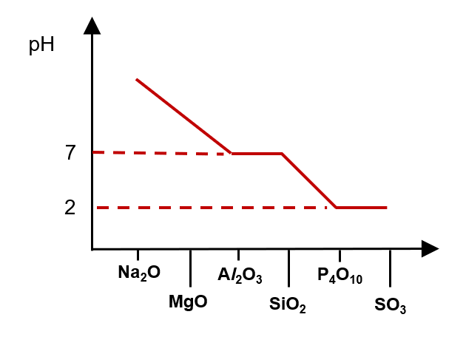
[Q1 Ans]
Sketch a graph to show the variation in pH of the resultant mixture formed from Period 3 oxides mixed with water.
[A]
Write equations for the reactions (if any) of the oxides: Na₂O, MgO, Al₂O₃ with water and state the pH of each resultant mixture.
Na₂O(s) + H₂O(l) → 2NaOH(aq); pH = 14
MgO(s) +H₂O(l) ⇌ Mg(OH)₂(s) ⇌ Mg(OH)₂(aq); pH = 10
Al₂O₃ does not dissolve in water; pH = 7
[B]
Write equations for the reactions (if any) of the oxides: SiO₂, P₄O₁₀, SO₃ with water and state the pH of each resultant mixture.
SiO₂ does not dissolve in water; pH = 7
P₄O₁₀(s) + 6H₂O(l) → 4H₃PO₄(aq); pH = 2
SO₃(g) + H₂O(l) → H₂SO₄(aq); pH = 2

Slide 3
[Q2 Ans]
[A]
Write an equation for any reaction that occurs between HCl(aq) and each oxide: Na₂O, Al₂O₃, P₄O₁₀
Na₂O(s) + 2HCl(aq) → 2NaCl(aq) + H₂O(l)
Al₂O₃(s) + 6HCl(aq) → 2AlCl₃(aq) + 3H₂O(l)
P₄O₁₀ does not react with HCl (aq)
[B]
Write an equation for any reaction that occurs between NaOH (aq) and each oxide: Na₂O, Al₂O₃, P₄O₁₀
Na₂O does not react with NaOH (aq)
Al₂O₃(s) + 2NaOH(aq)+ 3H₂O(l) → 2Na⁺[Al(OH)₄]⁻ (aq)
P₄O₁₀(s) + 12NaOH(aq)→ 4Na₃PO₄(aq) + 6H₂O(l)

Slide 4
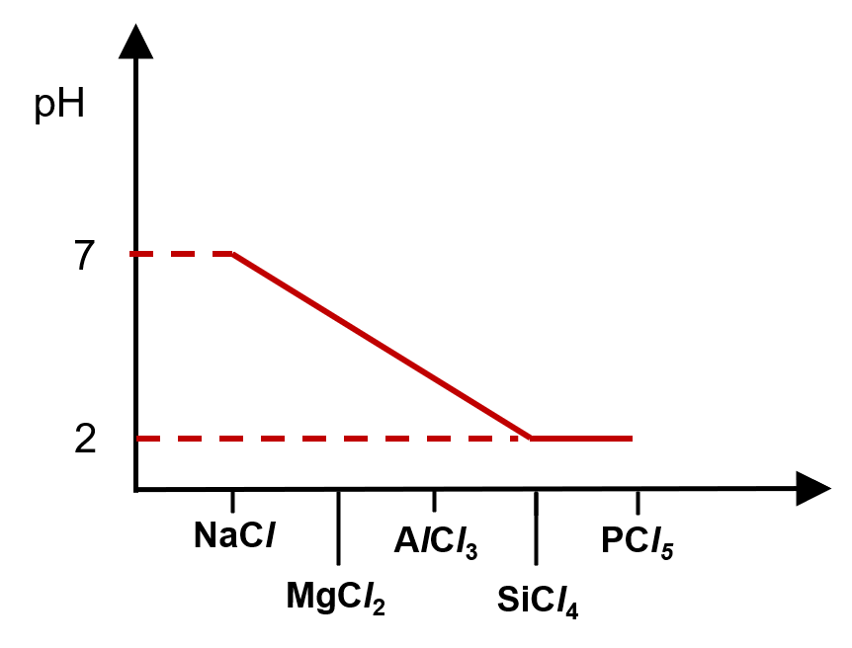
[Q3 Ans]
Sketch a graph to show the variation in pH of the resultant mixture formed from Period 3 chlorides mixed with excess water.
[A]
State the pH of the resultant mixture when the chlorides:
NaCl and AlCl₃ are separately mixed with excess water.
Write equations to explain your answer.
NaCl(s) + aq → Na⁺(aq) + Cl⁻(aq); pH = 7
AlCl₃(s) + 6H₂O(l) → [Al(H₂O)₆]³⁺(aq)+ 3Cl⁻(aq)
[Al(H₂O)₆]³⁺(aq) ⇌ [Al(H₂O)₅(OH)]²⁺(aq)+ H⁺(aq); pH = 3
[B]
State the pH of the resultant mixture when the chlorides:
SiCl₄ and PCl₅ are separately mixed with excess water.
Write equations to explain your answer.
SiCl₄(l) + 2H₂O(l) → SiO₂(s) + 4HCl(aq); pH = 2
PCl₅(s) + 4H₂O(l) → H₃PO₄(aq) + 5HCl(aq); pH = 2

Slide 5
[Q4 Ans]
Explain why MgCO₃ decomposes at a lower temperature than BaCO₃
[A]
State whether the following hydrogen halides decompose upon heating. (HF, HCl, HBr, HI)
Write equations to describe any thermal decomposition
HF: does not decompose on heating
HCl: does not decompose on heating
HBr: decompose slightly when heated
2HBr ⇌ H₂ + Br₂
HI: decompose readily when heated
2HI ⇌ H₂ + I₂
Mg²⁺ has a smaller cation radii, hence a higher charge density and greater polarising power than Ba²⁺
Mg²⁺ polarises the electron cloud of CO₃²⁻ to a greater extent and the covalent bonds in CO₃²⁻ are weakened to a greater extent. As a result, less energy required to break the covalent bonds, hence MgCO₃ decomposes at a lower temperature
[B]
Give two reason to explain why HI decomposes at a lower temperature than HBr
Since I is a larger atom than Br, the valence p orbital of the I is more diffuse. This results in less effective orbital overlap between the 1s orbital of H and the valence p orbital of I and hence the H─I bond is weaker
The electronegativity difference between H and I is less than between H and Br, as a result the H─I bond is less polar and hence the H─I bond is weaker

Slide 6
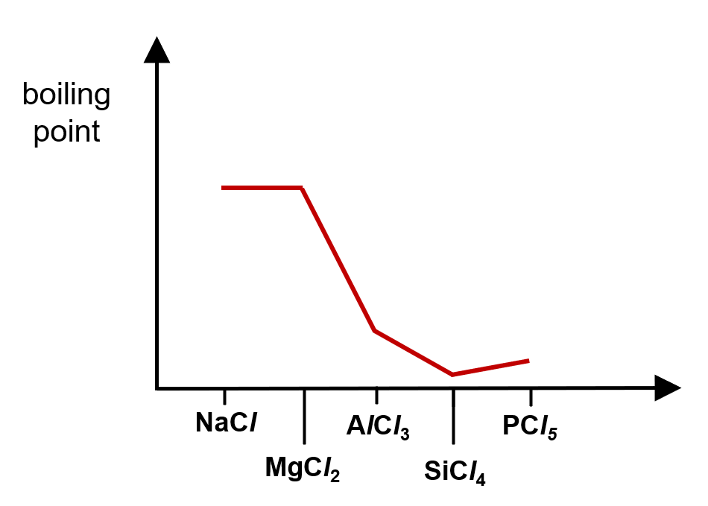
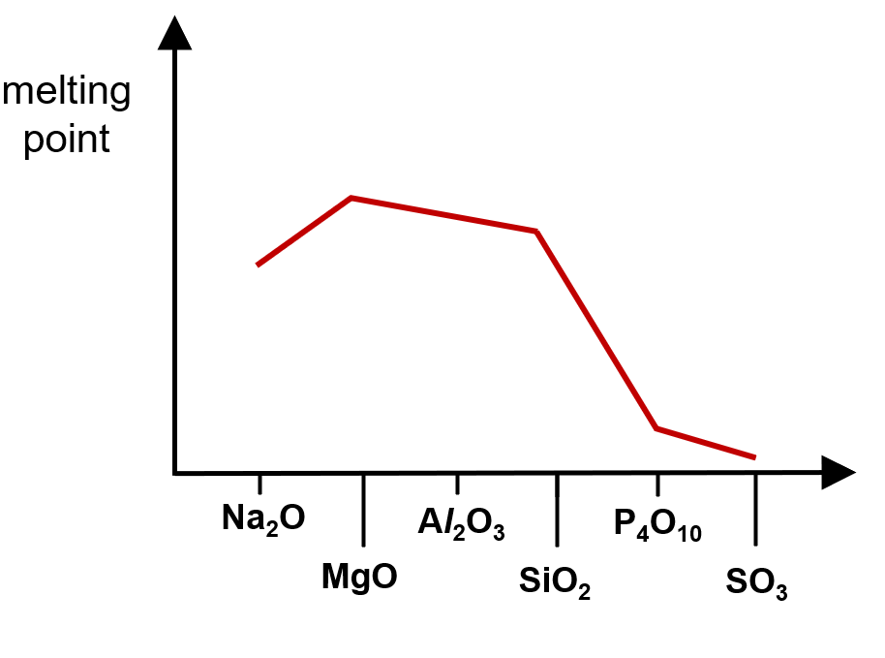
[Q5 Ans]
Sketch a graph to show the variation in melting point of the oxides in the third period, from Na to S.
Sketch a graph to show the variation in boiling point of the chlorides in the third period, from Na to P.

